Slide 1
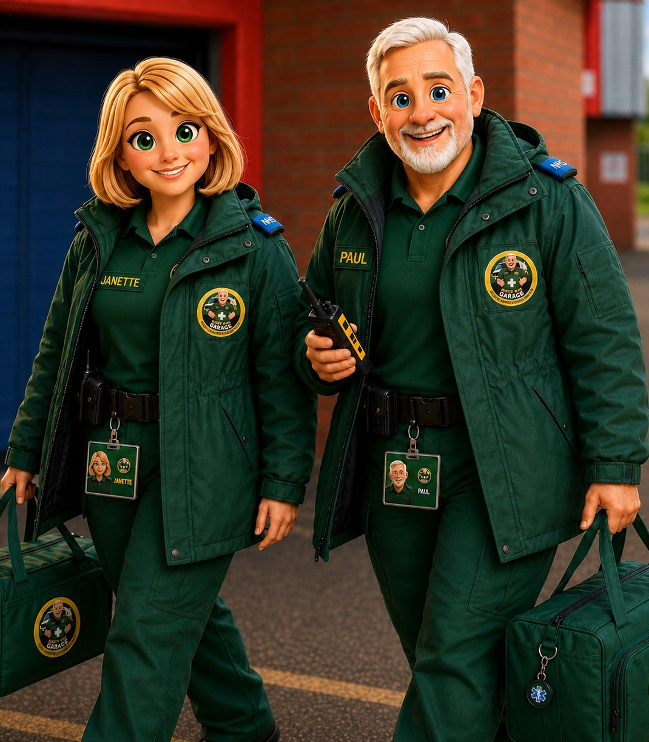

FIRST AID GARAGE
STAFF AWARENESS • ENGLAND
Allergy safety
in schools and
maintained nurseries
Guidance published July 2026
Policy • prevention • healthcare plans
training • emergency action
Based on Department for Education statutory guidance, July 2026
www.firstaidgarage.co.uk
Notes:
[Sources]
Department for Education, Allergy safety in schools statutory guidance, July 2026. https://www.gov.uk/government/publications/allergy-safety-in-schools

Slide 2
FIRST AID GARAGE
02
TRAINING THAT SAVES LIVES
START WITH THE RIGHT LEGAL POSITION
The current position is different for schools and nurseries
SCHOOLS
MAINTAINED NURSERIES
Statutory policy
duty
EYFS duties continue
Excluded from the new section 34 policy duty
Maintained schools, academies and PRUs
Must follow existing EYFS food, allergy and paediatric first-aid requirements
Must have a dedicated allergy safety policy and have regard to DfE guidance
Must have particular regard to the DfE guidance
Should treat the new DfE guidance as good practice
IMPORTANT
A nursery attached to a school should follow the school’s arrangements where they apply, alongside its own EYFS duties.
Source: DfE, Allergy safety in schools (July 2026), pp. 5–9; Children’s Wellbeing and Schools Act 2026, s.34.
www.firstaidgarage.co.uk
Notes:
[Sources]
Department for Education, Allergy safety in schools statutory guidance, July 2026. https://www.gov.uk/government/publications/allergy-safety-in-schools

Slide 3
FIRST AID GARAGE
03
TRAINING THAT SAVES LIVES
WHAT TO DO NOW
Prepare now with confidence
1
Lead
2
Identify
name a senior allergy-safety lead and use the DfE policy template
people, allergens, medicines and Individual Healthcare Plans
3
Train
4
Access
all staff in allergy awareness and emergency response—not just first aid
prescribed and spare adrenaline devices, unlocked and within five minutes
5
Include
6
Learn
food, activities, trips, transitions and allergy-related bullying
record incidents and near misses; rehearse emergency response
LEGAL NUANCE
Named leads, standalone staff-training duties and compulsory spare adrenaline devices are expected through further regulations. The guidance expects schools to prepare now.
Source: DfE statutory guidance, pp. 7–9, 20–25 and 38–44; GOV.UK governance guides, July 2026.
www.firstaidgarage.co.uk
Notes:
[Sources]
Department for Education, Allergy safety in schools statutory guidance, July 2026. https://www.gov.uk/government/publications/allergy-safety-in-schools

Slide 4
FIRST AID GARAGE
04
TRAINING THAT SAVES LIVES
THE POLICY BLUEPRINT
A useful policy tells staff exactly what happens next
Culture
Individual support
Annual awareness training; inclusion; wellbeing; allergy-related bullying
Identification; IHPs; Allergy/Asthma Action Plans; prescribed medication
Prevention
School-wide response
Known allergens; food provision; classroom activities; air/contact risks
Spare devices; trips; information sharing; incidents and near misses
Review at least annually—and after a serious incident or near miss.
Source: DfE statutory guidance, pp. 20–25 and 43–44.
www.firstaidgarage.co.uk

Slide 5
FIRST AID GARAGE
05
TRAINING THAT SAVES LIVES
IDENTIFY • PLAN • SHARE • REVIEW
Good records turn the policy into individual protection
ALLERGY RECORD
WHEN AN IHP IS NEEDED
Current photograph
The allergy has a functional impact, creates a risk of harm, and requires arrangements beyond the general policy.
Known allergens and triggers
Medication and location
Co-produce it with the pupil and parents or carers
IHP and Action Plan status
Attach the latest Allergy and/or Asthma Action Plan
Who needs to know
Review at least annually and after changes, incidents or near misses
START-OF-TERM RULE
For new starters, arrangements should be ready before the term begins.
Source: DfE statutory guidance, pp. 34–36 and 45–58.
www.firstaidgarage.co.uk

Slide 6
FIRST AID GARAGE
06
TRAINING THAT SAVES LIVES
REDUCE EXPOSURE WITHOUT EXCLUDING PUPILS
Allergy safety is wider than the dining hall
FOOD
Accurate allergen information, substitutions checked, cross-contact controlled
CLASSROOM
Review ingredients and materials used in cooking, science, art and craft
SITE
Consider contact and airborne allergens, pets, latex and cleaning products
TRIPS
Individual risk assessment, trained staff and immediate access to medication
INCLUSION
Do not segregate pupils at meals or block participation unnecessarily
DO NOT RELY ON A “NUT-FREE” CLAIM
A label cannot replace active controls, individual planning and a rehearsed response.
Source: DfE statutory guidance, pp. 27–34 and 42.
www.firstaidgarage.co.uk

Slide 7
FIRST AID GARAGE
07
TRAINING THAT SAVES LIVES
ALLERGY-AWARENESS TRAINING
Every adult on site should be able to recognise and respond
WHO
EVERYONE SHOULD BE ABLE TO
Permanent, temporary and supply staff; agency and peripatetic staff; caterers; breakfast/after-school teams; regular volunteers.
Recognise allergic reactions and ABC signs
Locate and administer emergency medication
Call 999 and inform parents or carers
First-aid training alone is not sufficient.
Follow IHPs and Allergy/Asthma Action Plans
Plan induction for new staff and a reliable briefing route for cover staff.
CURRENT POSITION
The guidance expects at least annual training; a standalone statutory training duty is due through forthcoming regulations.
Source: DfE statutory guidance, pp. 25–26.
www.firstaidgarage.co.uk
Notes:
[Sources]
Department for Education, Allergy safety in schools statutory guidance, July 2026. https://www.gov.uk/government/publications/allergy-safety-in-schools

Slide 8
FIRST AID GARAGE
08
TRAINING THAT SAVES LIVES
RECOGNISING DETERIORATION
A mild reaction can progress—keep watching for ABC
MILD TO MODERATE
ANAPHYLAXIS = ABC
Swollen lips, face or eyes
AIRWAY — throat/tongue swelling, hoarse voice, difficulty swallowing
Itchy or tingling mouth; hives
BREATHING — sudden wheeze, persistent cough, noisy or difficult breathing
Abdominal pain or vomiting
Sudden change in behaviour
CIRCULATION — dizzy, pale, floppy, confused, sleepy or unconscious
Do not leave them alone. Follow their plan and observe for at least 60 minutes.
Skin symptoms may be absent.
If in doubt, treat for anaphylaxis.
Source: DfE statutory guidance, pp. 15–18.
www.firstaidgarage.co.uk

Slide 9
THE DECISION POINT
ABC signs mean adrenaline—do not wait for a rash
A
AIRWAY
B
BREATHING
C
CIRCULATION
Swollen throat or tongue
Hoarse voice
Difficulty swallowing
Sudden wheeze
Persistent cough
Noisy or difficult breathing
Dizzy or faint
Pale or floppy
Confused or unconscious
Any one ABC sign: give adrenaline immediately and call 999.
Source: DfE statutory guidance, pp. 15–19.

Slide 10
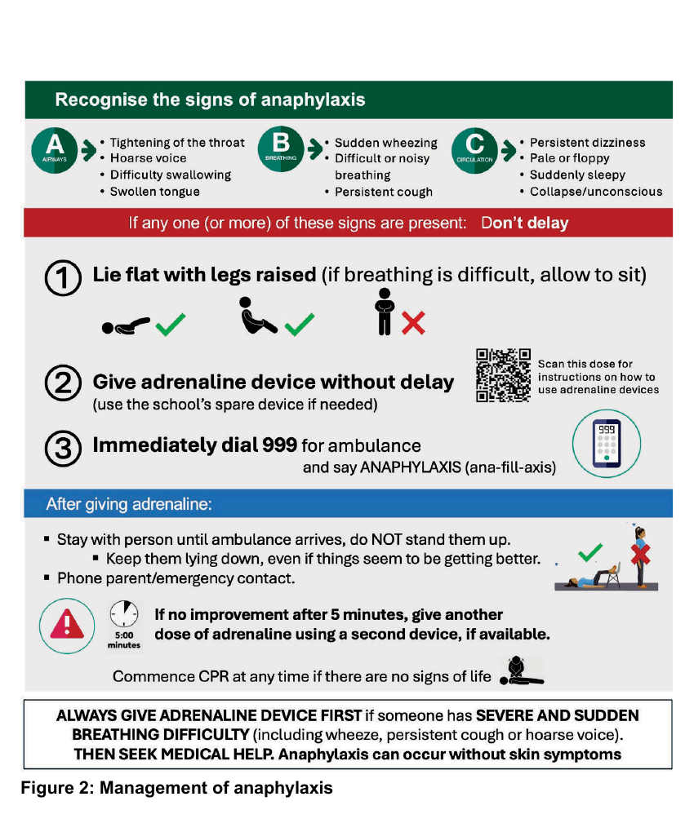
FIRST AID GARAGE
10
TRAINING THAT SAVES LIVES
KEEP THIS SEQUENCE VISIBLE AND REHEARSED
In an emergency, follow this order
1
LIE FLAT
Raise the legs. If breathing is difficult, allow sitting—but never standing or walking.
2
GIVE ADRENALINE
Use the prescribed device without delay; use the school spare if needed.
3
DIAL 999
Ask for an ambulance and say “ANAPHYLAXIS”.
4
STAY
Keep them down, monitor continuously and contact the parent or emergency contact.
5
REPEAT IF NEEDED
No improvement after 5 minutes: give a second dose. Start CPR if there are no signs of life.
Use the person’s own Allergy Action Plan and device instructions.
Source: DfE statutory guidance, Figure 2, p. 17.
www.firstaidgarage.co.uk

Slide 11
FIRST AID GARAGE
11
TRAINING THAT SAVES LIVES
ACCESS DETERMINES THE SITE PLAN
Adrenaline should be available within five minutes
FOR SCHOOLS
FOR EARLY YEARS
Prescribed devices must be rapidly accessible everywhere
The guidance states that the school spare-device arrangements do not extend to early-years settings.
Encourage pupils to carry their devices when appropriate
Spare devices: unlocked, clearly labelled and stored in pairs
Nurseries must ensure prescribed medication is immediately accessible and their emergency plan is workable.
Large or multi-site schools may need more than one location
Bring help and medicine to the person—never make them walk.
PREPARE NOW
Compulsory school stocking is expected through forthcoming regulations.
Source: DfE statutory guidance, pp. 36–42.
www.firstaidgarage.co.uk
Notes:
[Sources]
Department for Education, Allergy safety in schools statutory guidance, July 2026. https://www.gov.uk/government/publications/allergy-safety-in-schools

Slide 12
FIRST AID GARAGE
12
TRAINING THAT SAVES LIVES
TRIPS, ACTIVITIES AND TRANSITIONS
The plan must travel with the pupil
1
2
3
4
5
Check
Assess
Equip
Brief
Review
current IHP and Action Plan
the activity, travel, food and allergen risks
the pupil and staff with medication and contacts
everyone who needs to recognise and respond
after the trip, a change or a near miss
TRANSITION
Share the previous IHP and Action Plans, then the receiving setting creates a new IHP for its own arrangements.
Source: DfE statutory guidance, pp. 42, 51 and 57–58.
www.firstaidgarage.co.uk

Slide 13
FIRST AID GARAGE
13
TRAINING THAT SAVES LIVES
USE A NO-BLAME LEARNING CYCLE
Every incident and near miss should strengthen the system
1
2
3
4
Make safe
Record
Report
Review
Treat first; preserve evidence where relevant
What happened, where, when and who was involved
Parents/carers, governing body and statutory bodies where required
Policy, IHP, food controls, access and training
Near miss = no harm, but serious harm could reasonably have occurred.
GOVERNANCE
Report trends to governors and use them in the annual policy review.
Source: DfE statutory guidance, pp. 43 and 59–67.
www.firstaidgarage.co.uk

Slide 14
FIRST AID GARAGE
14
TRAINING THAT SAVES LIVES
EYFS SAFEGUARDS FOR MAINTAINED NURSERIES
Nursery allergy safety begins before the child starts
BEFORE ADMISSION
Obtain dietary, allergy, intolerance and health information
AT EVERY MEAL
Name who checks that each child receives the correct food
WHILE EATING
Have a staff member with a valid full paediatric first-aid certificate in the room
WITH FAMILIES
Keep discussions active and update the IHP when needs change
WITH STAFF
Share relevant information and teach symptoms and emergency treatment
WITH CLINICIANS
Attach and follow the child’s current Allergy Action Plan
GOOD PRACTICE
Use the DfE allergy safety policy framework even though maintained nursery schools are outside the new section 34 policy duty.
Source: DfE statutory guidance, pp. 8 and 33–34; EYFS statutory framework.
www.firstaidgarage.co.uk

Slide 15
FIRST AID GARAGE
STAFF READINESS CHECK
Before the first pupil arrives
Every member of staff should be able to answer these five questions:
1
Who in our setting has a known allergy?
2
Where are their plans and emergency medicines?
3
What ABC signs mean anaphylaxis?
4
Can adrenaline reach any location within five minutes?
5
How do I record and report an incident or near miss?
Read the guidance: gov.uk/government/publications/allergy-safety-in-schools
www.firstaidgarage.co.uk • training@firstaidgarage.co.uk

Slide 16
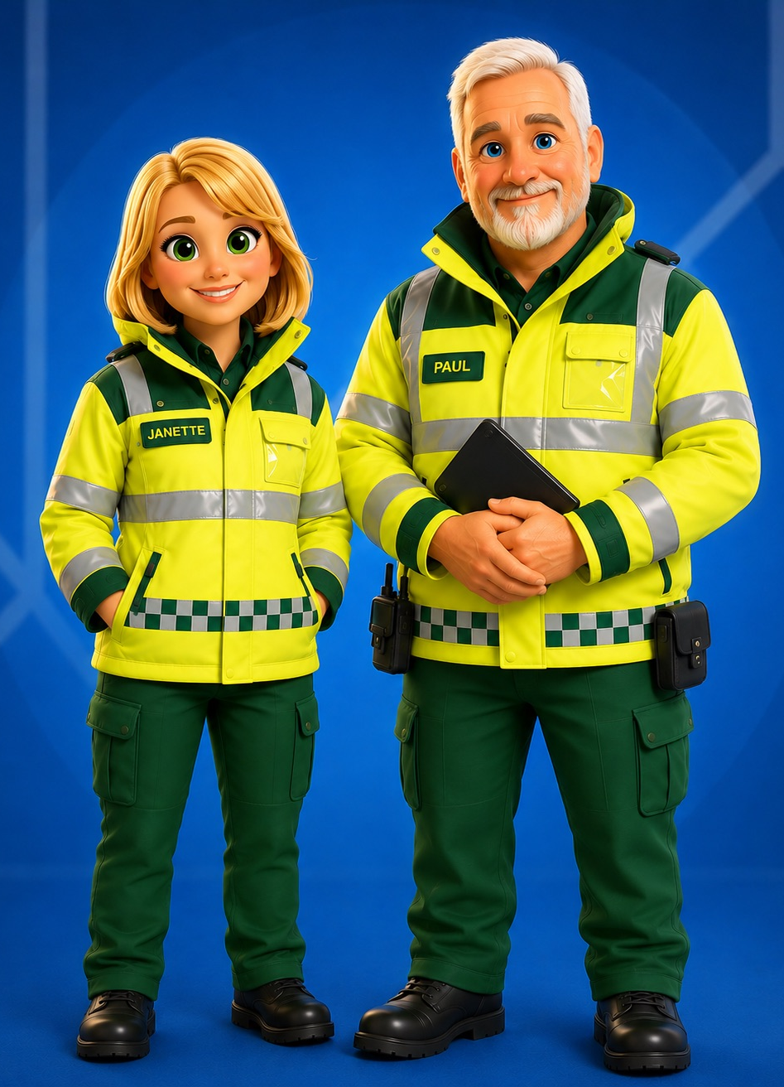
SUPPORT FOR SCHOOLS & NURSERIES
Make allergy safety
a whole-team habit
Help staff recognise anaphylaxis, locate emergency medication and act without delay.
AVAILABLE FROM FIRST AID GARAGE
Anaphylaxis & Auto-injectors online course
Staff awareness resources and downloadable factsheet
www.firstaidgarage.co.uk
training@firstaidgarage.co.uk

